Slide 1
Nuclear Fuel Performance
NE-533
Spring 2025

Slide 2
Housekeeping
Questions/comments on MOOSE?
Exam grades:
Average: 75.9, Stdev: 11.7
Curve of 10 points applied to your scores
Any questions/comments on grading, let me know and come to office hours
Solutions posted on Moodle

Slide 3
Mechanics

Slide 4

Solid mechanics
When a load is applied to a body, it changes shape and perhaps size
Motions throughout a body are called displacements
u(r, t)
Rigid body displacements do not change the shape and/or size
the rigid body is translated
Changes in shape and/or size are call deformations
The objective of Solid Mechanics is to relate loads (applied force) to deformation

Slide 5
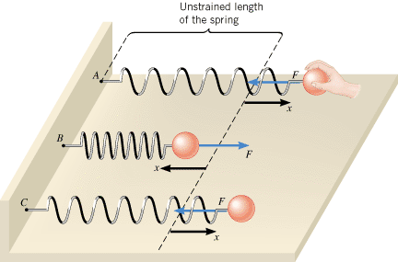
Ideal springs
It can be instructive to view solids as a spring
When we apply some force F, we get some displacement x
F = k x
When the spring is displaced by x, there is force that responds in the opposite direction equal to kx
Due to the displacement, there is a stored energy E = ½ k x²

Slide 6
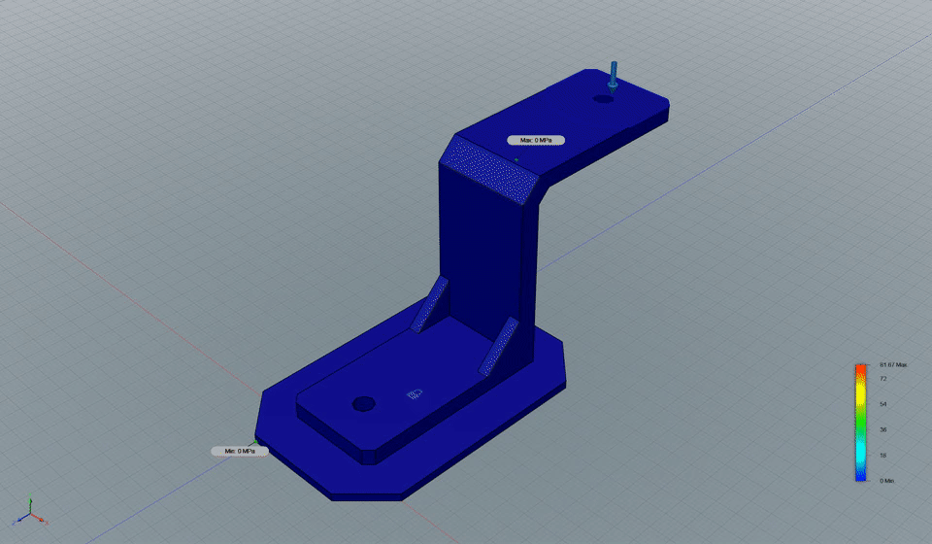
Observed deformation due to a force
Solid mechanics is similar to the behavior of an ideal spring but throughout a body
An applied load results results in deformation.
The internal strain is like the displacements x
The internal stress is like the internal force F

Slide 7
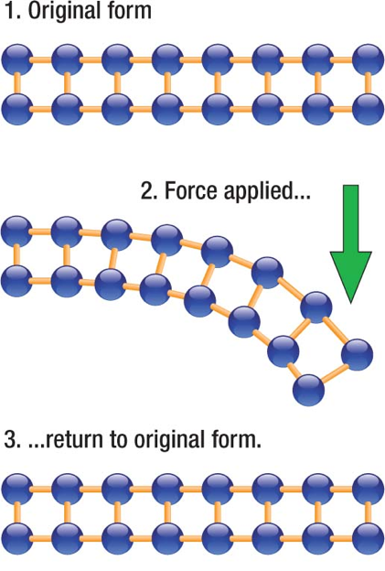
Elasticity
Elasticity is the ability of a body to resist a distorting influence and to return to its original size and shape when that influence or force is removed
In elastic deformation, we are stretching the atomic bonds
The more we stretch the bonds, the more force it takes to stretch
When we release the load, the atoms spring back into their lattice sites

Slide 8
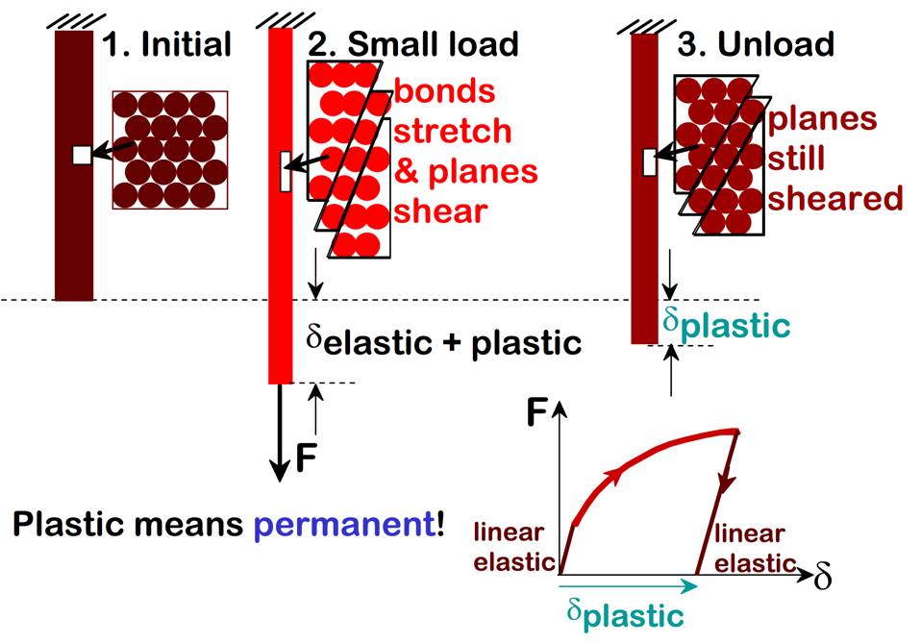
Plasticity
Plasticity is the ability of a solid material to undergo permanent deformation, a non-reversible change of shape in response to applied forces
Plastic deformation is observed in most materials
The transition from elastic behavior to plastic behavior is known as yielding

Slide 9
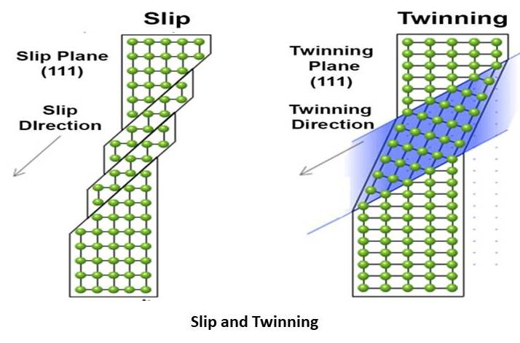
Plasticity
Plasticity is typically caused by two modes of deformation in the crystal lattice: slip and twinning
Slip is a shear deformation which moves the atoms through many interatomic distances relative to their initial positions
Twinning is the plastic deformation which takes place along two planes due to an applied force
Ductility (total elongation), Yield Strength, etc. are dependent upon temperature and composition
Plasticity typically increases at higher temperature

Slide 10
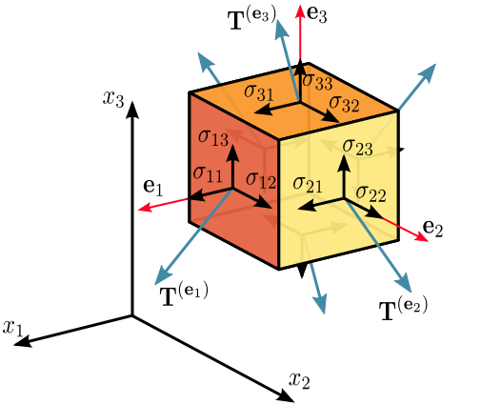
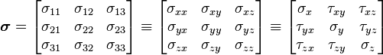
Stress
Stress is a physical quantity that expresses the internal forces that neighboring particles of a continuous material exert on each other
Stress is a force per unit area with SI units of Pa = N/m²
The stress is a 2nd order tensor (a 3 by 3 matrix): Cauchy stress tensor
σ_{ij} = F_{ij}/A_{i}
i is the face the force is applied and j is the direction it is applied
Sigmas are normal stress components, taus are shear stress components

Slide 11
Stress as a response
The stress in a material is the RESPONSE to an applied load (force) or an applied displacement
Uniaxial tension or compression
Only one non-zero stress: σ_{ii} (σ₁₁, σ₂₂, σ₃₃)
Tension means positive stress, compression negative
Examples: Cables, tension tests
Pure shear
Only one non-zero stress: (σ₁₂, σ₁₃, σ₂₃)
Examples: drive shaft
Biaxial tension/compression
Two non-zero stress (e.g. σ₁₁ = 1, σ₂₂ = 2)
Examples: Pressure cylinder or vessel
Hydrostatic compression (pressure)
σ₁₁ = σ₂₂ = σ₃₃ = -p
Anything underwater

Slide 12
Last Time
MOOSE overview
On Moodle: slides posted, project posted, submission opened
Started module 2
Intro to mechanics
Solid mechanics predicts the deformation of a body from its applied load
The strain defines the deformation
The stress defines the material’s response to the strain
Materials can have recoverable and permanent deformation
Elastic deformation is recoverable and occurs due to the stretching of the atomic lattice
Plastic deformation is permanent and results form the breaking of bonds

Slide 13
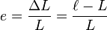
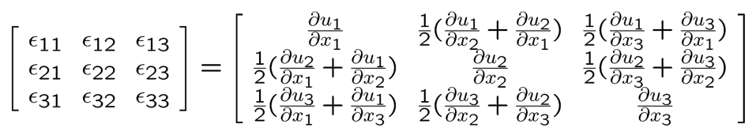
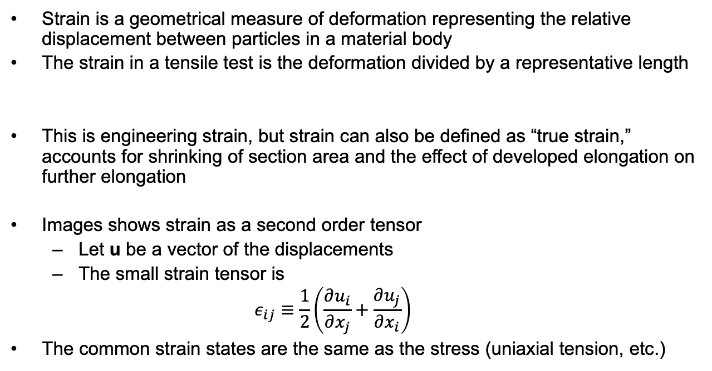
Strain
Strain is a geometrical measure of deformation representing the relative displacement between particles in a material body
The strain in a tensile test is the deformation divided by a representative length
This is engineering strain, but strain can also be defined as “true strain,” accounts for shrinking of section area and the effect of developed elongation on further elongation
Images shows strain as a second order tensor
Let u be a vector of the displacements
The small strain tensor is
$$ε_{ij}≡\frac{1}{2}\left(\frac{∂u_{i}}{∂x_{j}}+\frac{∂u_{j}}{∂x_{i}}\right)$$
The common strain states are the same as the stress (uniaxial tension, etc.)

Slide 14
Strain produces stress
A deformation (strain) results in stress within a material
For small strains, the stress is elastic and is a linear function of the strain
For larger deformation, some of the strain is elastic and increases the stress. The rest is plastic and does NOT contribute to the stress.
The elastic energy density in a material is a scalar quantity equal to

Slide 15
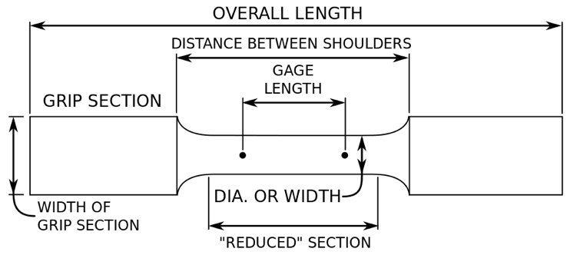
Tensile testing
The most common means of determining mechanical properties is a uniaxial tension test
Apply a uniaxial load until failure
Properties that are directly measured via a tensile test include ultimate tensile strength, maximum elongation, Young’s modulus, Poisson’s ratio, etc.

Slide 16
Stress/strain from a tensile test
A₀ = Initial cross section area
A = deformed cross section area
P or F applied load/force
Engineering True
stress σ
strain ε

Slide 17
Stress vs strain curves

Slide 18
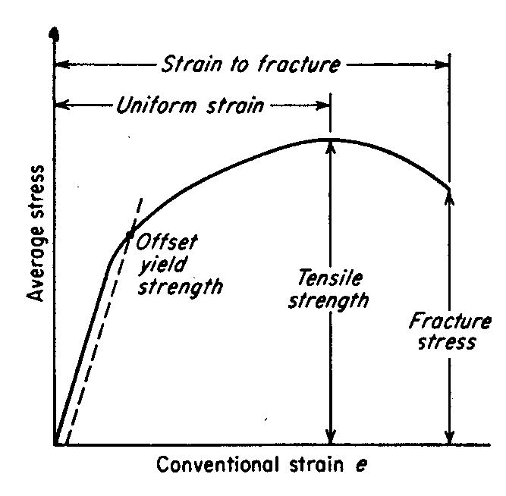
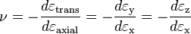
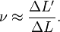
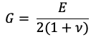
Using stress/strain curves
In the elastic portion of the stress-strain curve, the stress varies linearly with strain
The slope of the line is Young’s Modulus, E:
Poisson’s ratio, ν, is the ratio of the shrinkage in cross section due to the extension in the pulling direction
Can obtain the shear modulus (G) from the elastic modulus and Poisson’s ratio

Slide 19
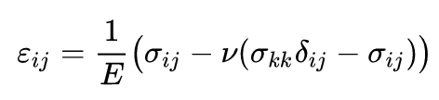
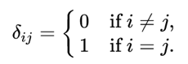
Using stress/strain curves
The shear modulus, G, defines the stress to strain ratio in shear
For isotropic materials, G = E / ( 2 (1 + ν))
In matrix form, the elasticity/stiffness tensor from Hooke's law for isotropic materials can be written as

Slide 20
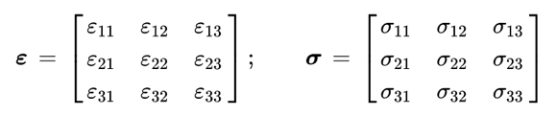
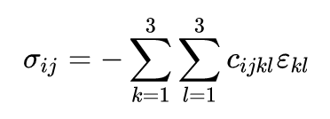
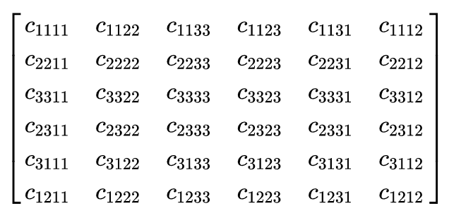
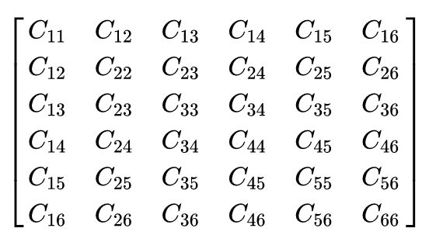
Isotropic and Anisotropic
Being a linear mapping between the nine numbers σ_{ij} and the nine numbers ε_{kl}, the stiffness tensor c is represented by a matrix of 3 × 3 × 3 × 3 = 81 real numbers
Given minor symmetries of the stiffness tensor, c_{ijkl} = c_{jikl}, this 81 elastic constants can be reduced to 36
Major symmetries, c_{ijkl} = c_{klij}, reduce this number from 36 to 21
Isotropic materials deform the same way no matter in what direction you deform them.
They have 2 unique elastic constants, C₁₁ and C₁₂
Anisotropic materials behave differently in different directions
The elasticity tensor can have 21 unique components defining anisotropy
Orthotropic materials have 9 unique elastic constants
Cubic structured materials have 3 unique elastic constants (UO₂)
Hexagonal structured materials have 5 unique elastic constants
Polycrystalline anisotropic materials can behave as isotropic, because the various grains average out

Slide 21
Isotropic elastic properties for some materials
Material | E (GPa) | ν
Aluminum | 70.3 | 0.345
Gold | 78.0 | 0.44
Iron | 211.4 | 0.293
Nickel | 199.5 | 0.312
Tungsten | 411.0 | 0.28
Zircaloy | 80.0 | 0.41
UO₂ | 200.0 | 0.345

Slide 22
Elastic constants are not “constant”
Properties change with temperature
The decrease in elastic constants with temperature is called softening
Young’s modulus is typically a function of temperature, decreasing with increasing temperature
Shear Modulus and Poisson’s ratio can also change with T

Slide 23
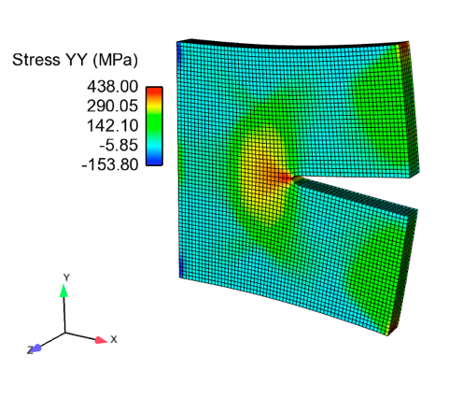
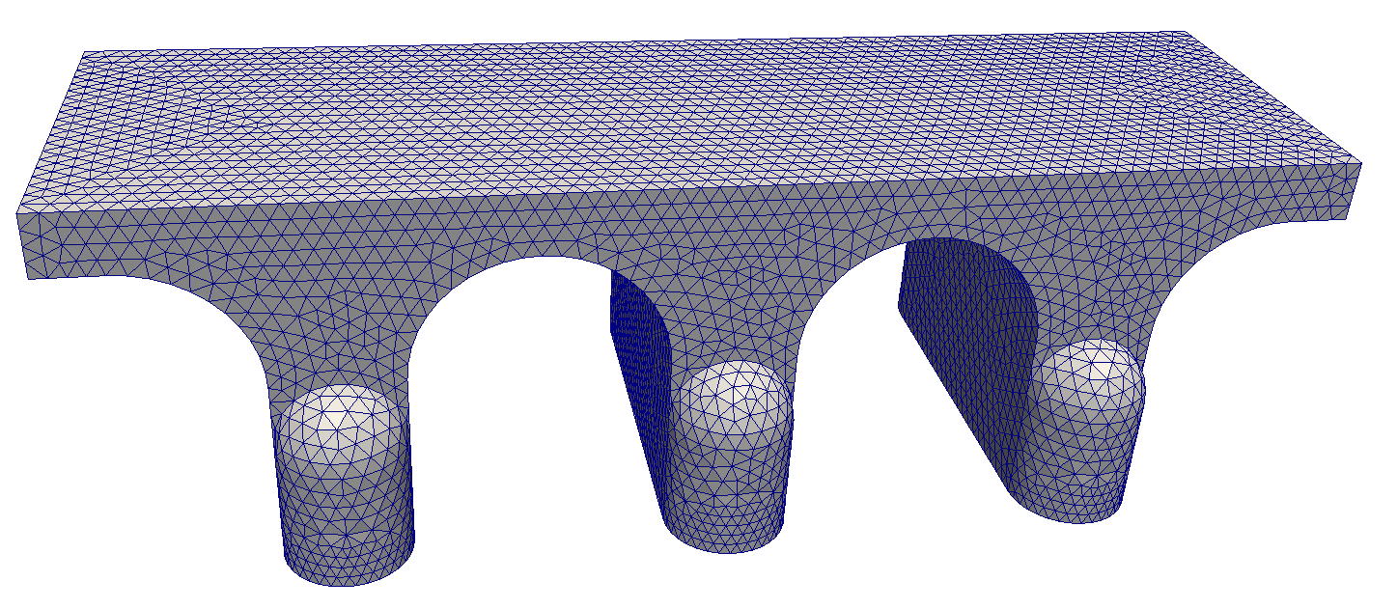
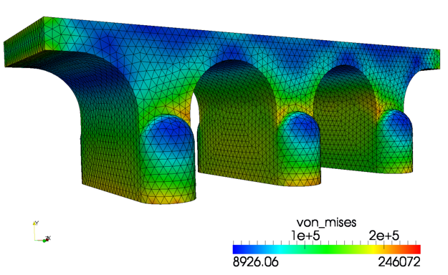
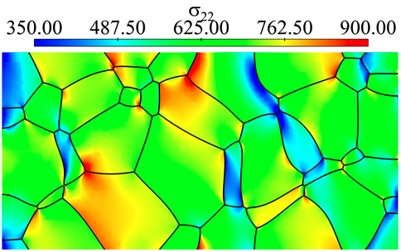
In actual materials, the stress and the strain change throughout the material

Slide 24
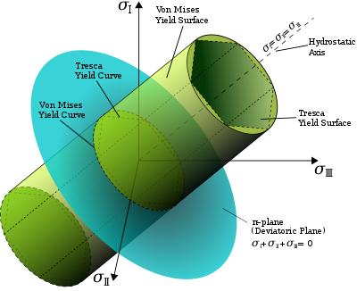
von Mises yield criterion
The maximum distortion criterion (also von Mises yield criterion) states that yielding of a ductile material begins when the second invariant of deviatoric stress (J2) reaches a critical value
A material is said to start yielding when the von Mises stress reaches the yield strength
The von Mises stress satisfies the property where two stress states with equal distortion energy have an equal von Mises stress
The von Mises stress is used to predict yielding of materials under complex loading and the results of uniaxial tensile tests

Slide 25
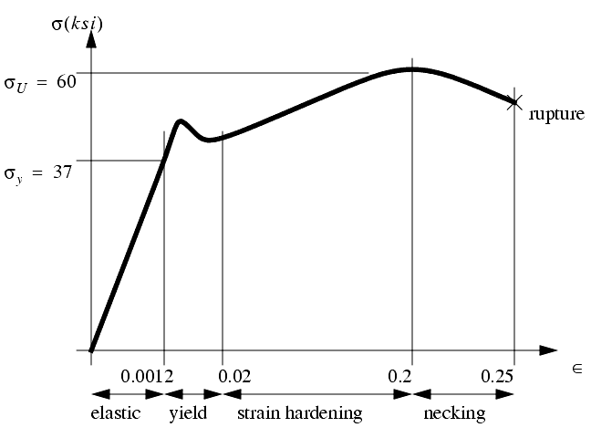
Stress/Strain Regions
Once the stress reaches the yield stress, it plastically deforms
σ_{y} is the yield stress
σ_{U} is the ultimate tensile stress
The final stress before rupture is called the fracture stress

Slide 26
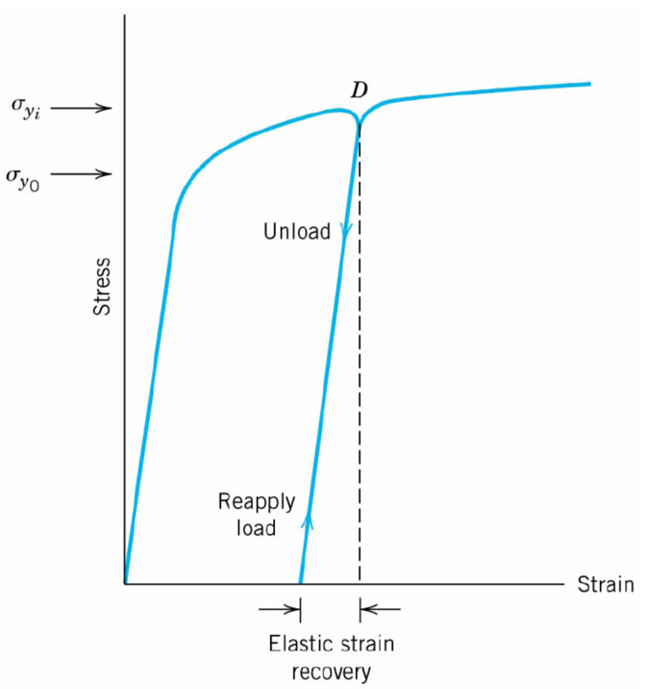
Permanent Strain
After plastic deformation, if you unload the sample, it still has the permanent strain
The plastic behavior has modified the microstructure, and has increased the yield point
After unloading, the strain hardening has changed the material
Thus, if you reload, the yield stress is often higher than it was previously

Slide 27
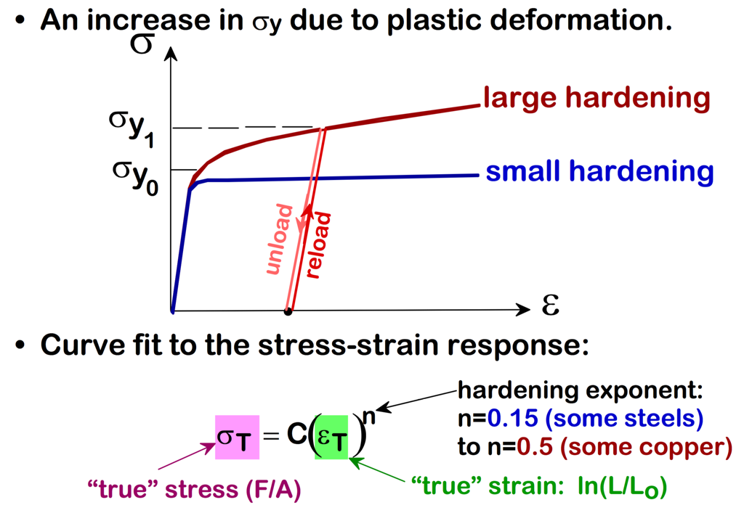
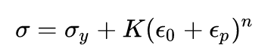
The hardening behavior changes for different materials
K is a strength coefficient, n is the strain hardening exponent, ε₀ is the prior plastic strain, ε_{p} is the plastic strain, and σ_{y} is the original yield strength
The strain hardening exponent is a material property, with a value between 0 and 1
A value of 0 means that a material is a perfectly plastic solid, while a value of 1 represents a 100% elastic solid.

Slide 28
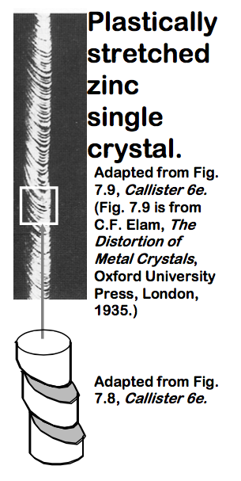
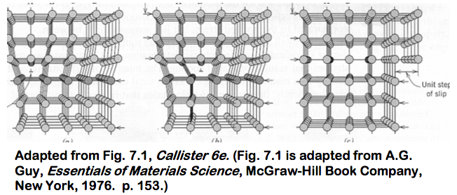
Dislocation motion
Plastic deformation occurs due to dislocation motion
A dislocation is a line defect
Edge and screw type
When it moves, only a small number of bonds are broken at a time

Slide 29
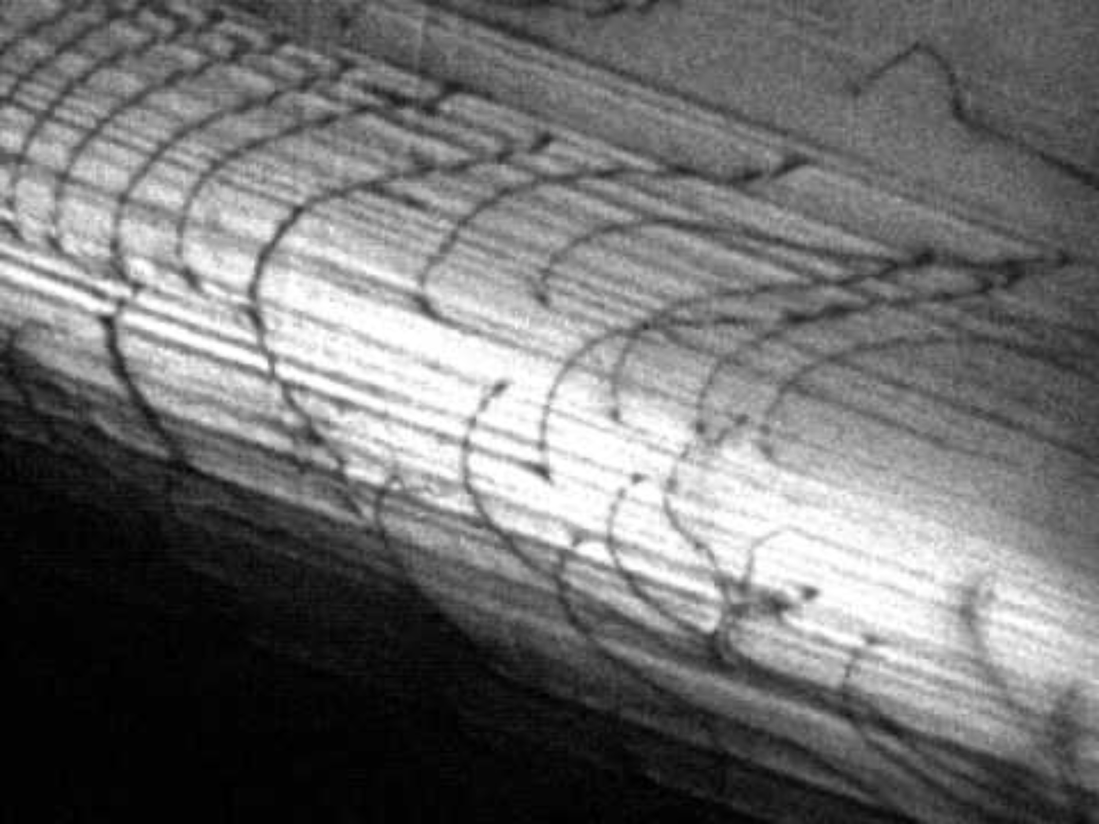
Dislocation are produced and move during deformation
https://www.youtube.com/watch?v=EXbiEopDJ_g

Slide 30
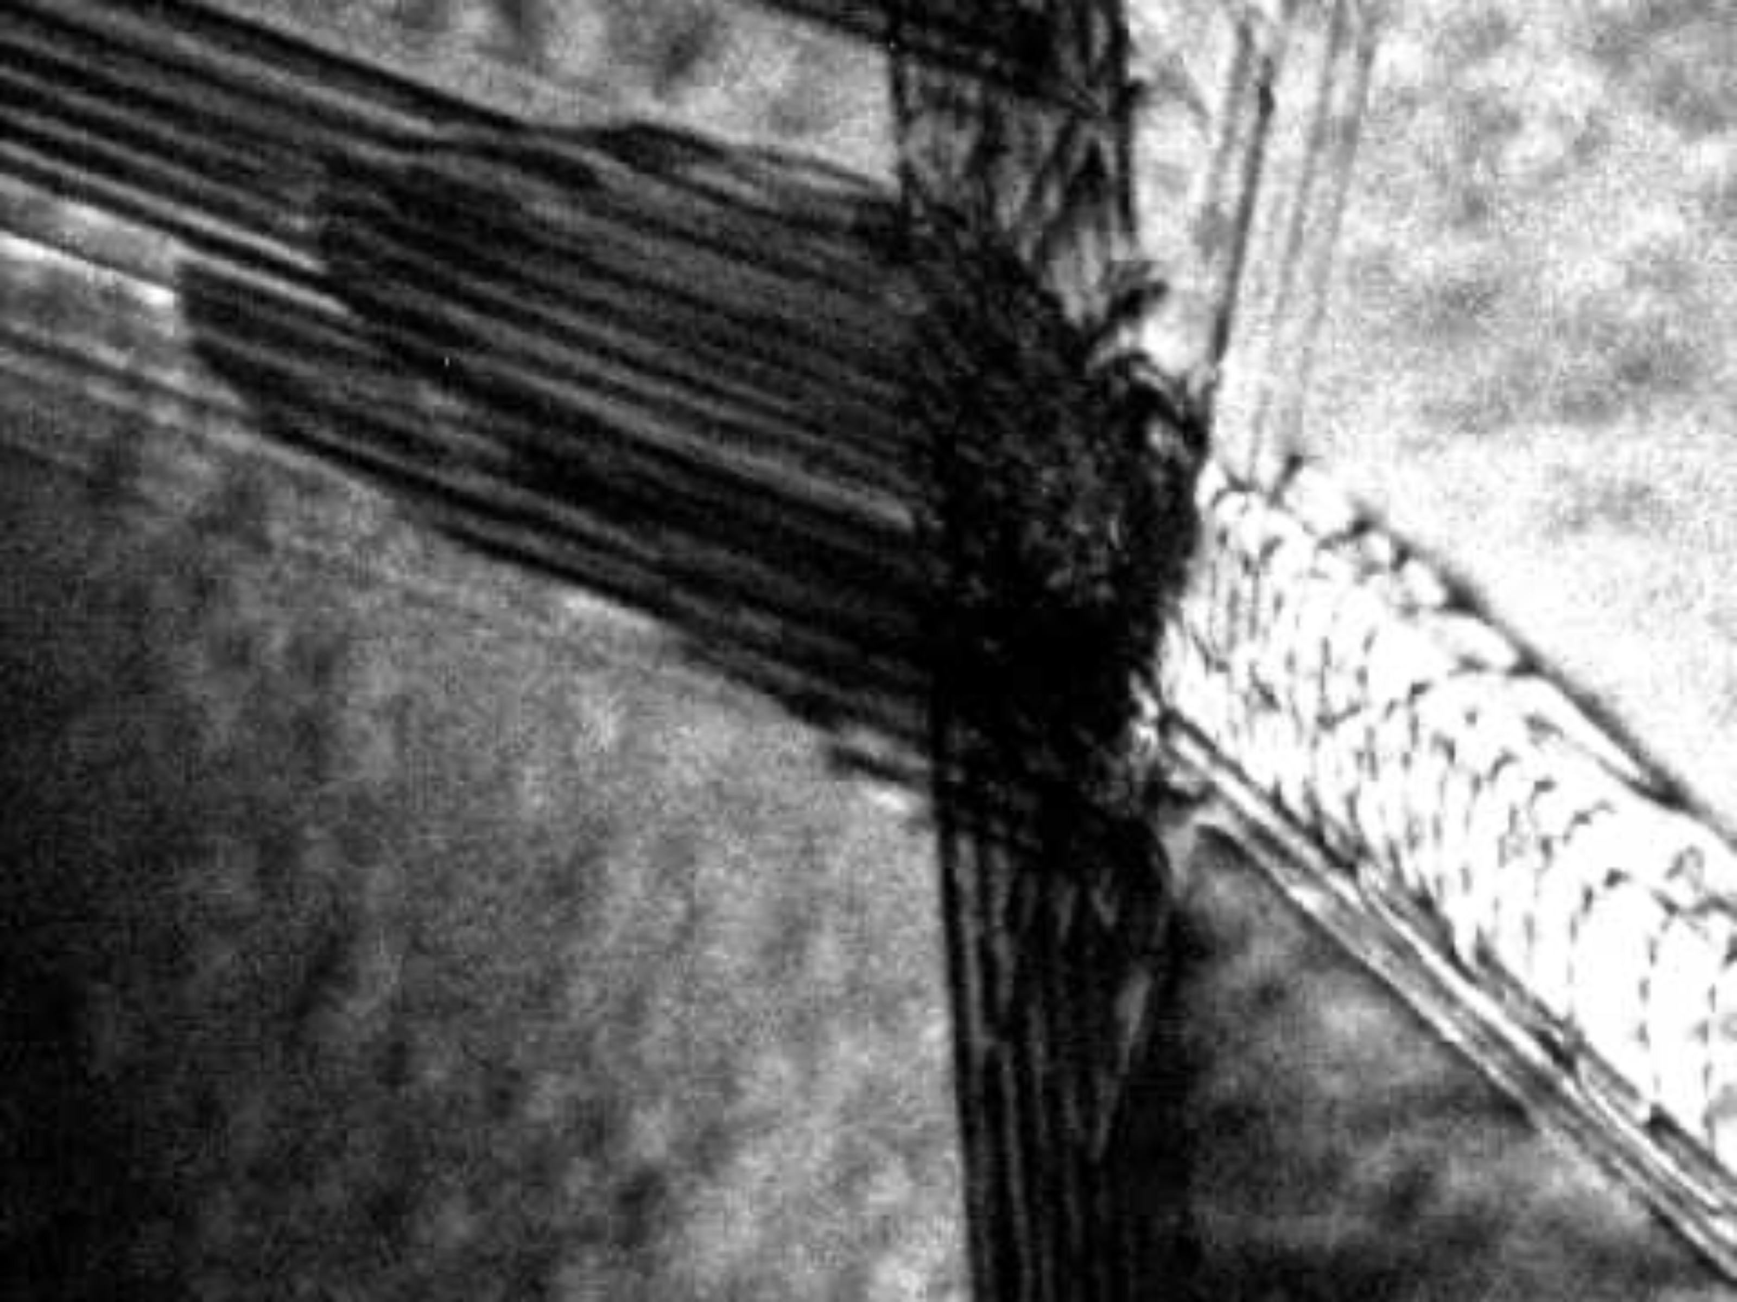
Dislocation motion causes plastic deformation, dislocation pileup causes hardening
https://www.youtube.com/watch?v=JjWdEj_LjZo

Slide 31
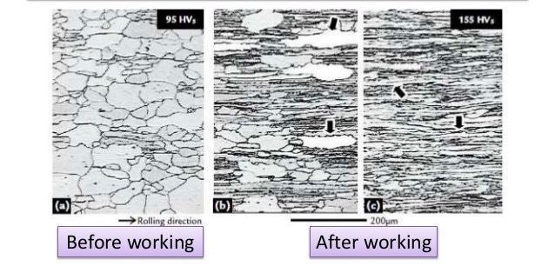
Dislocation Pile Up
Dislocation motion can be inhibited by barriers, including grain boundaries, precipitates, voids, bubbles, etc.

Slide 32
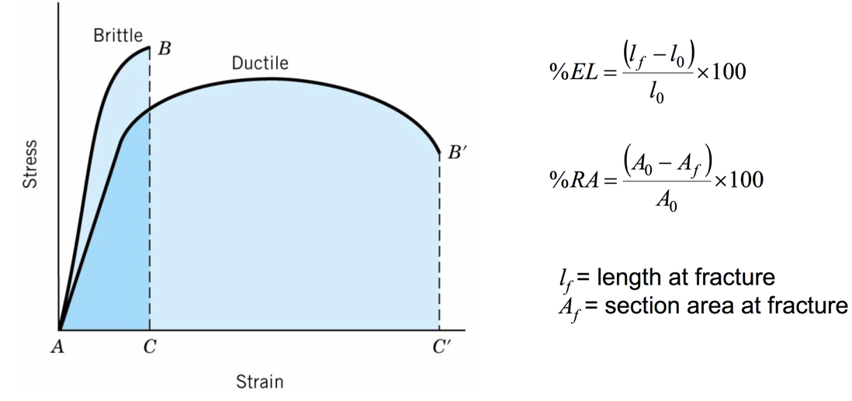
Ductility
Ductile materials plastically deform significantly, brittle materials do not
Quantities defining ductility are total percent elongation at fracture (%EL) and the percent reduction in area (%RA)
The ductile–brittle transition temperature (DBTT) of a metal is the temperature at which the fracture energy passes below a predetermined value
Below the DBTT, failure is brittle
Cold working and neutron irradiation can increase the DBTT, potentially reducing ductility of reactor components

Slide 33
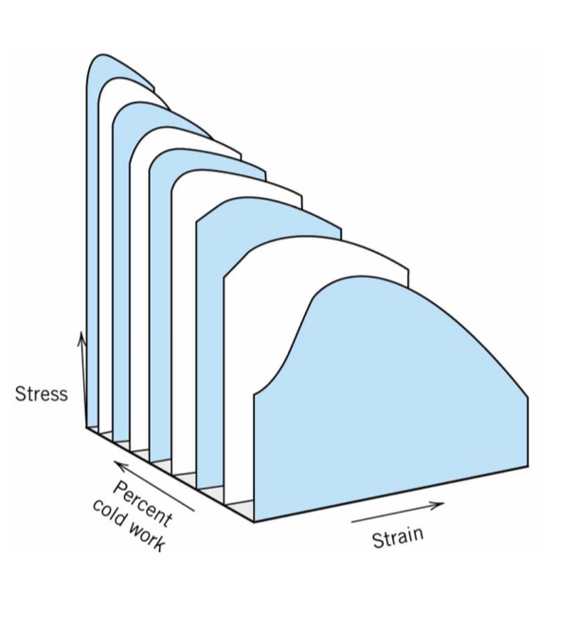
As the strength increases due to dislocation pile-up, the ductility decreases
Toughness is the ability of a material to absorb energy and plastically deform without fracturing
Toughness is related to the area under the stress–strain curve
In order to be tough, a material must be both strong and ductile
Materials are often work hardened prior to utilization to modify mechanical properties

Slide 34
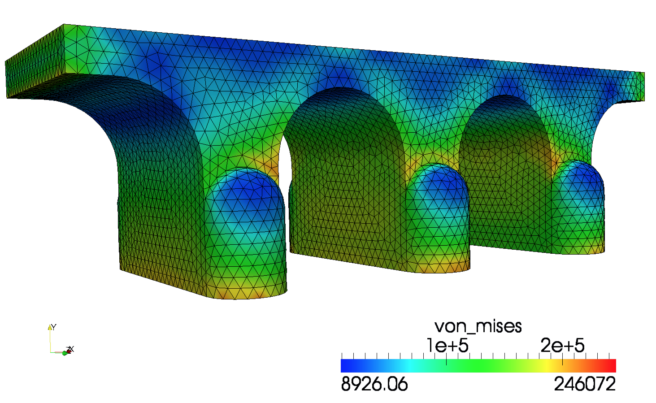
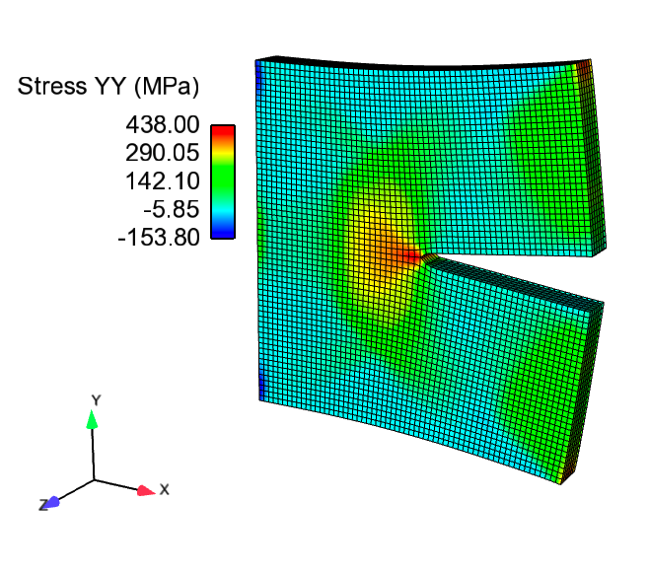
Determine the stress and strain throughout a body

Slide 35
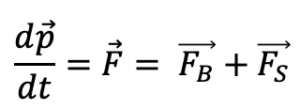
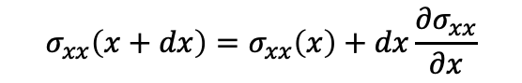
The stress divergence equation derivation
$$\frac{d\vec{p}}{dt}=\vec{F}= \vec{F_{B}}+\vec{F_{S}}$$
Generalized momentum conservation:
Considering a cubic element, surface forces act on the walls of the cube
Force on a wall is the product of the stress and the surface area
For wall at dx, approximate stress via Taylor expansion
$$σ_{xx}\left(x+dx\right)=σ_{xx}\left(x\right)+dx\frac{{∂σ}_{xx}}{∂x}$$

Slide 36
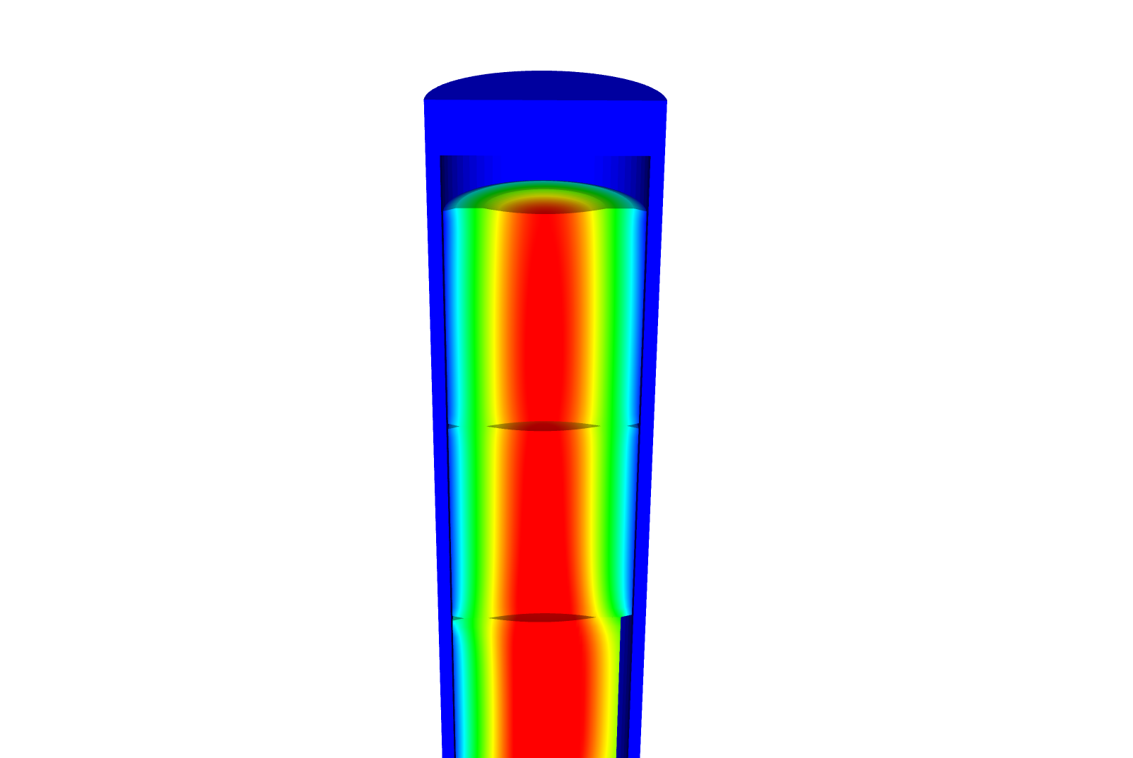
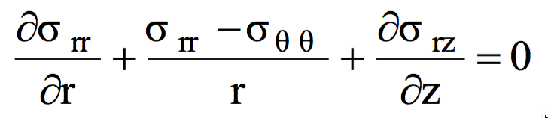
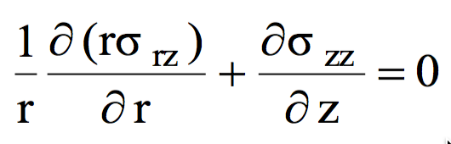
Simplified Cauchy for our typical system
Assumption 1: We have a static body
Assumption 2: Gravity is negligible
Assumption 3: The problem is axisymmetric
z
θ
r

Slide 37
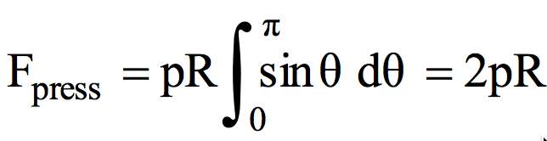
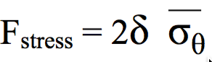
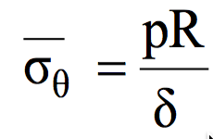
Solve for the stress throughout a pressurized cylinder (cladding tube) with thin walls
Because our cylinder has such thin walls (δ = thickness), we can simplify everything to simple force balance
The hoop stress is the force exerted circumferentially in both directions on every particle in the cylinder wall
First, we need the Force per unit length due to the pressure
Utilize force to hoop stress relation:
Then we equate the forces and solve for the hoop stress

Slide 38
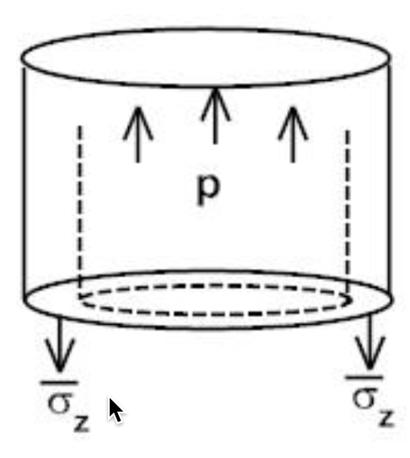
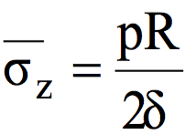
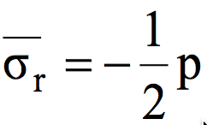
Other two stresses for a thin-walled closed cylinder
To find the stress in the z-direction we do another force balance
Again, we equate the forces and solve for the stress
Last, the stress on the inside of the wall is –p and on the outside is zero
F_{top}
F_{wall}

Slide 39
Determine if a fuel rod will exceed its yield stress
A fuel rod has an initial pressure of 5 MPa that increases to 9 MPa during operation. Will it exceed its yield stress?
R = 0.55 cm, δ = 0.05 cm, σ_{y} = 381 MPa
The largest stress will be the hoop stress
The hoop stress is P*(0.55/.05)
For 5 MPa, σθ = 55 Mpa
For 9 MPa, σθ = 99 Mpa
With these pressures, we don’t come even close to the yield stress of the cladding

